Slide 1
Objectives
In this session, you will learn to:
  Perform drag-and-drop operations using clipboard
Notes:
Students have already learnt the basic syntax and program structure in C#. They have already designed console based application. Now the students will be familiarized with windows based applications.
Start the session by sharing the session objectives with the students.

Slide 2
Performing Drag-and-Drop Operation Using Clipboard
Drag-and-drop operation:
  It enables you to drag an item from one location to another in an application.
  VC# provides some properties, methods, and events associated with various controls to implement drag-and-drop and clipboard features.
Notes:
Before discussing this topic with the students, the faculty must demonstrate the drag-and-drop operation using any of the Windows based application such as wordpad or notepad.
Although the students would have already worked with the clipboard while working with MS-Word or MS-Exccel, the faculty should also discuss the features of clipboard with the students.
Using this and the next two slides, explain to the students that they can use a clipboard in their VC# applications with the help of Clipboard functions.

Slide 3
The Drag-and-Drop Operation Events
The common events used to perform drag-and-drop operations are:
  ItemDrag
  DragEnter
  DragOver
  DragDrop
  DragLeave
  GiveFeedback
Notes:
The faculty must also discuss these Drag-and-Drop operation events with the students.

Slide 4
The Drag-and-Drop Operation Phases
To perform the drag-and-drop operation, the user has to perform the following steps:
  1. Call the DoDragDrop() method.
  Handle the events, such as DragEnter, DragLeave, and GiveFeedback to provide information about the
  drag-and-drop operation to the user.
  Set the AllowDrop property of the destination control to true.
  4. Write code in the DragDrop event of the destination control.
Notes:
Before discussing this topic with the students, the faculty must demonstrate the drag-and-drop operation using any of the Windows based application such as wordpad or notepad.
Although the students would have already worked with the clipboard while working with MS-Word or MS-Exccel, the faculty should also discuss the features of clipboard with the students.
Using this and the next two slides, explain to the students that they can use a clipboard in their VC# applications with the help of Clipboard functions.

Slide 5

Providing Clipboard Support in a Windows Forms Application
What is a clipboard?

Slide 6

Providing Clipboard Support in a Windows Forms Application (Contd.)
A clipboard is a temporary storage area for any application running on Windows operating system.

Slide 7
Providing Clipboard Support in a Windows Forms Application (Contd.)
The System.Windows.Forms.Clipboard class provides various methods to implement clipboard functionality in a VC# application.
The three different operations associated with the clipboard are:
  Storing data on clipboard
  Identifying the type of data on clipboard
  Retrieving data from clipboard
To do so, use methods such as SetAudio(), SetData(), SetImage()
To do so, use methods like ContainsAudio(), ContainsData(), ContainsImage()
To do so, use methods like GetAudioStream(), GetData(), GetImage()

Slide 8
Just a minute
Which event occurs when a user drags an item in a TreeView or ListView control?
  1. DragEnter event
  2. DragOver event
  3. GiveFeedback event
  4. ItemDrag event
Answer:
  4. ItemDrag event

Slide 9
Performing Drag-and-Drop Operation Between Applications
The following code snippet helps the user to drag text from WordPad file and drop the text in the TextBox control on a form:
private void textBox1_DragEnter(object sender,DragEventArgs e)
{
if(e.Data.GetDataPresent(DataFormats.Text))
e.Effect = DragDropEffects.Copy;
else
e.Effect = DragDropEffects.None; }
Notes:
For the following example to be functional, you need to add a text box control named textBox1 to the form and write the given code in the corresponding textbox events

Slide 10
Performing Drag-and-Drop Operation Between Applications (Contd.)
private void textBox1_DragDrop(object sender, DragEventArgs e)
{
textBox1.Text = e.Data.GetData(DataFormats.Text).ToString();
}

Slide 11
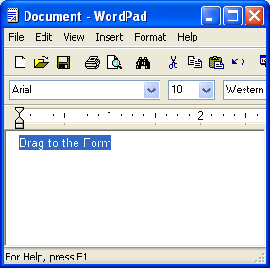
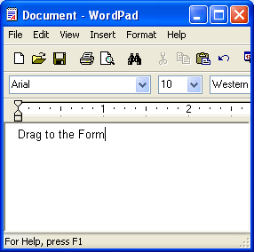
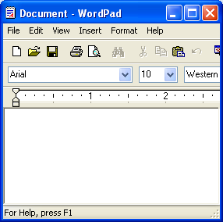
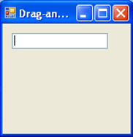
Performing Drag-and-Drop Operation Between Applications (Contd.)
The following figures show the drag-and-drop operation between applications.
Drag to the Form

Slide 12
Summary
In this session, you learned that:
  The drag-and-drop function enables the user to move an item on a form from one location to another.
  There are various events that need to be handled to support the drag-and-drop operation in an application. These events are:
    ItemDrag event
    DragEnter event
    DragOver event
    DragDrop event
    DragLeave event
    GiveFeedback event
  A clipboard is the temporary repository of data.
  The clipboard function can be incorporated in the application by using the methods provided by the System.Windows.Forms.Clipboard class.
Notes:
You can summarize the session by using the summary given in the slides.
In addition, you can also ask students to summarize what they have learnt in this session.

